Slide 1
Interactive Twitter Data Visualization Word Cloud
Mehmet Duman

Slide 2
Goals?
Get data from twitter data and generate most used word visualization
Find Historical twitter data for 2016 Presidential Election day
Create Word Cloud to analyze twitter social media for selected filter

Slide 3
What is Twitter ?
Online news and social networking service
6,000 /sec - 500 Million /day - 200 Billion /year (2016)
40 million tweets sent by 10pm about 2016 U.S. election day
Twitter platform offers access to that corpus of data, via Twitter APIs
Query result would be in JSON format ( Advantage of Python, php, Ruby)
Some of the Twitter restrictions;
3,200 of a User’s most recent Tweets (by screen_name or user_id)
The Twitter Search API searches Tweets published in the past 7 days.
User timelines belonging to protected users may only be requested
Notes:
https://dev.twitter.com/docs
https://en.wikipedia.org/wiki/Twitter
http://www.nytimes.com/2016/11/09/technology/for-election-day-chatter-twitter-ruled-social-media.html?_r=0
http://www.dsayce.com/social-media/10-billions-tweets/
https://dev.twitter.com/rest/public/search
https://dev.twitter.com/rest/reference/get/statuses/user_timeline

Slide 4
What Technologies Used for Project?
Python
Tweepy library for accessing Twitter API
JSON
Wordcloud library
JavaScript
D3.js Visualization

Slide 5
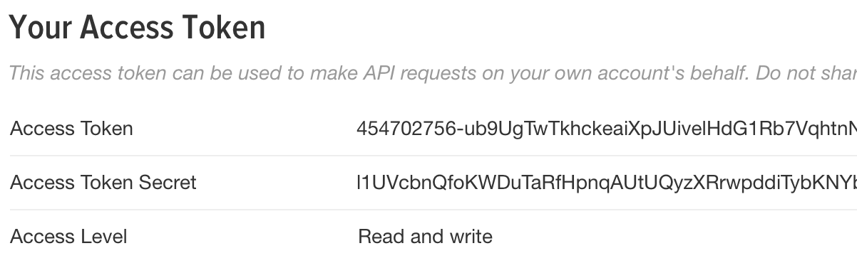
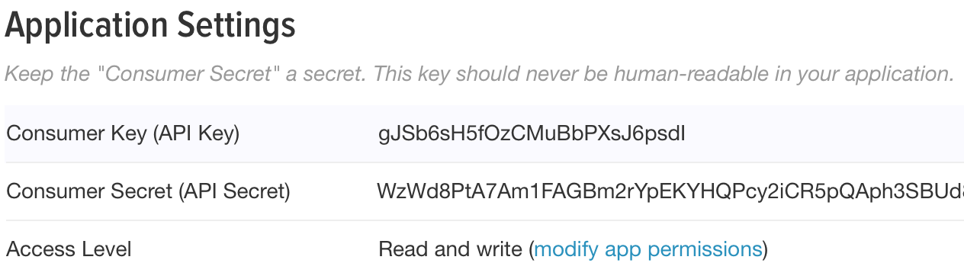
How to get tweets? - Twitter Account
Create a twitter account
After logging create new "Applications“ to get communication data with Twitter API

Slide 6
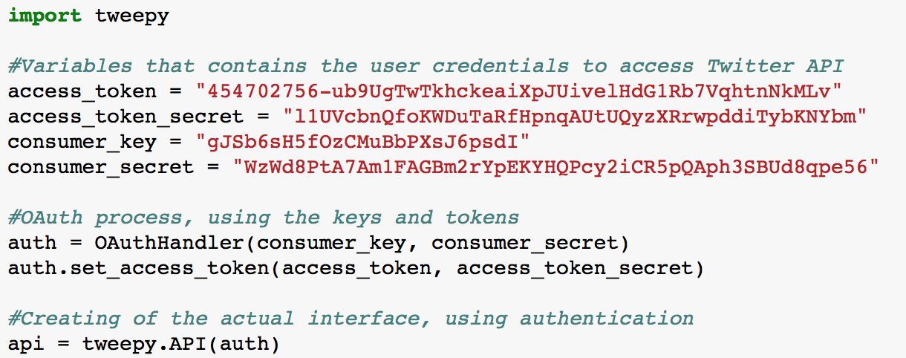

How to get tweets? - Tweepy – connection to Twitter API
Open-sourced Python library
Enables to communicate with Twitter platform and uses Twitter API
A sample of how to access the Twitter API

Slide 7
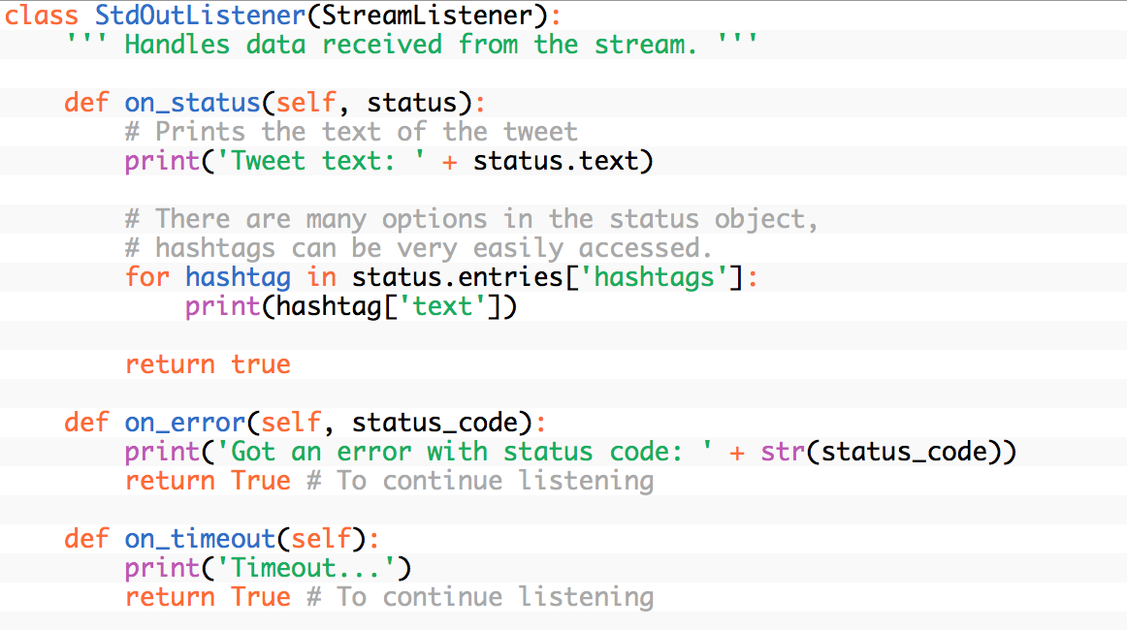
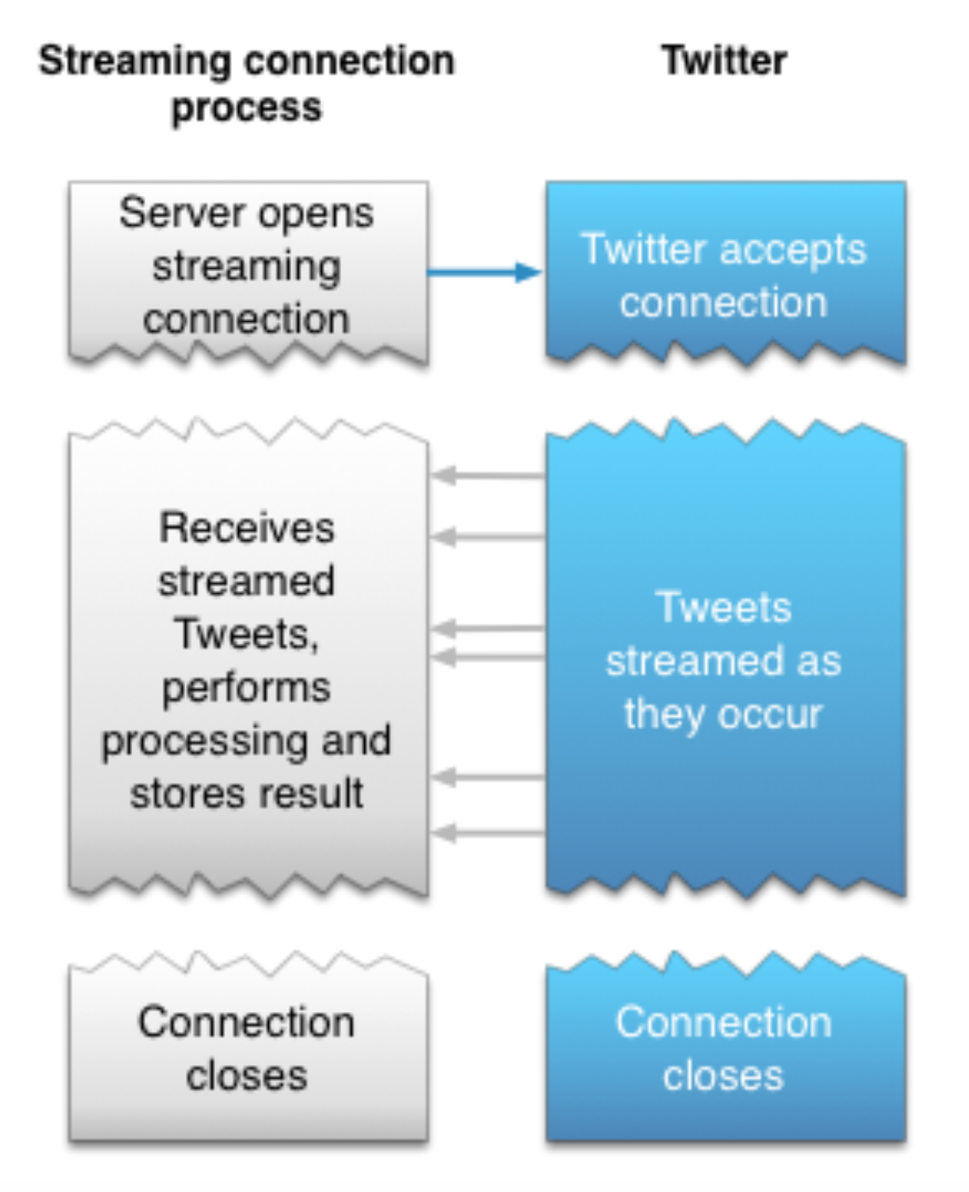
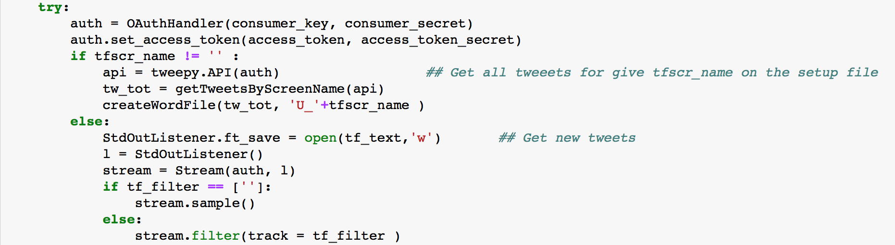
How to get tweets? - Tweepy StreamingAPI
Monitoring for tweets and doing actions in real time and catches them when some event happens
Notes:
StreamListener has several methods, with
on_data() and
on_status() being the most useful ones. Here is a sample program which implements this behavior:

Slide 8
How to get tweets? - tweet sample
{"created_at":"Fri Nov 25 19:31:34 +0000 2016","id":802233284218368001,"id_str":"802233284218368001","text":"OH MY GOD: LOOK WHAT HAPPENED IMMEDIATELY AFTER TRUMP LANDED IN FLORIDA FOR THANKSGIVING! https:\/\/t.co\/WzB6edU0Rl https:\/\/t.co\/kTWKZxPCdF","display_text_range":[0,113],"source":"\u003ca href=\"http:\/\/dlvr.it\" rel=\"nofollow\"\u003edlvr.it\u003c\/a\u003e","truncated":false,"in_reply_to_status_id":null,"in_reply_to_status_id_str":null,"in_reply_to_user_id":null,"in_reply_to_user_id_str":null,"in_reply_to_screen_name":null,"user":{"id":772922637953667072,"id_str":"772922637953667072","name":"Students4Trump8","screen_name":"AnnaAlvarez1992","location":"South Carolina, USA","url":null,"description":"We believe students who think in honest objective terms make better citizens.\u201c.@students4trump8","protected":false,"verified":false,"followers_count":2254,"friends_count":2307,"listed_count":16,"favourites_count":7,"statuses_count":47840,"created_at":"Mon Sep 05 22:21:31 +0000 2016","utc_offset":-25200,"time_zone":"Arizona","geo_enabled":false,"lang":"es","contributors_enabled":false,"is_translator":false,"profile_background_color":"000000","profile_background_image_url":"http:\/\/abs.twimg.com\/images\/themes\/theme1\/bg.png","profile_background_image_url_https":"https:\/\/abs.twimg.com\/images\/themes\/theme1\/bg.png","profile_background_tile":false,"profile_link_color":"F58EA8","profile_sidebar_border_color":"000000","profile_sidebar_fill_color":"000000","profile_text_color":"000000","profile_use_background_image":false,"profile_image_url":"http:\/\/pbs.twimg.com\/profile_images\/772925759614750720\/D2dkyku0_normal.jpg","profile_image_url_https":"https:\/\/pbs.twimg.com\/profile_images\/772925759614750720\/D2dkyku0_normal.jpg","profile_banner_url":"https:\/\/pbs.twimg.com\/profile_banners\/772922637953667072\/1473123472","default_profile":false,"default_profile_image":false,"following":null,"follow_request_sent":null,"notifications":null},"geo":null,"coordinates":null,"place":null,"contributors":null,"is_quote_status":false,"retweet_count":0,"favorite_count":0,"entities":{"hashtags":[],"urls":[{"url":"https:\/\/t.co\/WzB6edU0Rl","expanded_url":"http:\/\/viid.me\/qq2WHi","display_url":"viid.me\/qq2WHi","indices":[90,113]}],"user_mentions":[],"symbols":[],"media":[{"id":802233280405721088,"id_str":"802233280405721088","indices":[114,137],"media_url":"http:\/\/pbs.twimg.com\/media\/CyIa6wmUUAApLWH.jpg","media_url_https":"https:\/\/pbs.twimg.com\/media\/CyIa6wmUUAApLWH.jpg","url":"https:\/\/t.co\/kTWKZxPCdF","display_url":"pic.twitter.com\/kTWKZxPCdF","expanded_url":"https:\/\/twitter.com\/AnnaAlvarez1992\/status\/802233284218368001\/photo\/1","type":"photo","sizes":{"medium":{"w":660,"h":330,"resize":"fit"},"thumb":{"w":150,"h":150,"resize":"crop"},"small":{"w":660,"h":330,"resize":"fit"},"large":{"w":660,"h":330,"resize":"fit"}}}]},"extended_entities":{"media":[{"id":802233280405721088,"id_str":"802233280405721088","indices":[114,137],"media_url":"http:\/\/pbs.twimg.com\/media\/CyIa6wmUUAApLWH.jpg","media_url_https":"https:\/\/pbs.twimg.com\/media\/CyIa6wmUUAApLWH.jpg","url":"https:\/\/t.co\/kTWKZxPCdF","display_url":"pic.twitter.com\/kTWKZxPCdF","expanded_url":"https:\/\/twitter.com\/AnnaAlvarez1992\/status\/802233284218368001\/photo\/1","type":"photo","sizes":{"medium":{"w":660,"h":330,"resize":"fit"},"thumb":{"w":150,"h":150,"resize":"crop"},"small":{"w":660,"h":330,"resize":"fit"},"large":{"w":660,"h":330,"resize":"fit"}}}]},"favorited":false,"retweeted":false,"possibly_sensitive":false,"filter_level":"low","lang":"en","timestamp_ms":"1480102294388"}

Slide 9
How to get tweets? - tweet sample
{"created_at":"Fri Nov 25 19:31:34 +0000 2016",
"id":802233284218368001,
"id_str":"802233284218368001",
"text":"OH MY GOD: LOOK WHAT HAPPENED IMMEDIATELY AFTER TRUMP LANDED IN FLORIDA FOR THANKSGIVING! https:\/\/t.co\/WzB6edU0Rl https:\/\/t.co\/kTWKZxPCdF",
"display_text_range":[0,113],
"source":"\u003ca href=\"http:\/\/dlvr.it\" rel=\"nofollow\"\u003edlvr.it\u003c\/a\u003e",
"truncated":false,
"in_reply_to_status_id":null,
"in_reply_to_status_id_str":null,
"in_reply_to_user_id":null,
"in_reply_to_user_id_str":null,
"in_reply_to_screen_name":null,
"user":{"id":772922637953667072,
"id_str":"772922637953667072",
"name":"Students4Trump8",
"screen_name":"AnnaAlvarez1992",
"location":"South Carolina, USA",
"url":null,
"description":"We believe students who think in honest objective terms make better citizens.\u201c.@students4trump8",
"protected":false,
"verified":false,
"followers_count":2254,
"
friends_count":2307,
"listed_count":16,
"favourites_count":7,
"statuses_count":47840,
"created_at":"Mon Sep 05 22:21:31 +0000 2016",
"utc_offset":-25200,
"time_zone":"Arizona",
"geo_enabled":false,
"lang":"es",
"contributors_enabled":false,
"is_translator":false,
"profile_background_color":"000000",
"profile_background_image_url":"http:\/\/abs.twimg.com\/images\/themes\/theme1\/bg.png",
"profile_background_image_url_https":"https:\/\/abs.twimg.com\/images\/themes\/theme1\/bg.png",
"profile_background_tile":false,
"profile_link_color":"F58EA8",
"profile_sidebar_border_color":"000000",
"profile_sidebar_fill_color":"000000",
"profile_text_color":"000000",
"profile_use_background_image":false,
"profile_image_url":"http:\/\/pbs.twimg.com\/profile_images\/772925759614750720\/D2dkyku0_normal.jpg",
"profile_image_url_https":"https:\/\/pbs.twimg.com\/profile_images\/772925759614750720\/D2dkyku0_normal.jpg",
"profile_banner_url":"https:\/\/pbs.twimg.com\/profile_banners\/772922637953667072\/1473123472",
"default_profile":false,
"default_profile_image":false,
"following":null,
"follow_request_sent":null,
"notifications":null},
"geo":null,
"coordinates":null,
"place":null,
"contributors":null,
"is_quote_status":false,
"retweet_count":0,
"favorite_count":0,
"favorite_count":0,
"entities":{"hashtags":[],
"urls":[{"url":"https:\/\/t.co\/WzB6edU0Rl",
"expanded_url":"http:\/\/viid.me\/qq2WHi",
"display_url":"viid.me\/qq2WHi",
"indices":[90,113]}],
"user_mentions":[],
"symbols":[],
"media":[{"id":802233280405721088,
"id_str":"802233280405721088",
"indices":[114,137],
"media_url":"http:\/\/pbs.twimg.com\/media\/CyIa6wmUUAApLWH.jpg",
"media_url_https":"https:\/\/pbs.twimg.com\/media\/CyIa6wmUUAApLWH.jpg","url":"https:\/\/t.co\/kTWKZxPCdF",
"display_url":"pic.twitter.com\/kTWKZxPCdF",
"expanded_url":"https:\/\/twitter.com\/AnnaAlvarez1992\/status\/802233284218368001\/photo\/1",
"type":"photo",
"sizes":{"medium":{"w":660,"h":330,"resize":"fit"},
"thumb":{"w":150,"h":150,"resize":"crop"},
"small":{"w":660,"h":330,"resize":"fit"},
"large":{"w":660,"h":330,"resize":"fit"}}}]},
"extended_entities":{"media":[{"id":802233280405721088,
"id_str":"802233280405721088",
"indices":[114,137],
"media_url":"http:\/\/pbs.twimg.com\/media\/CyIa6wmUUAApLWH.jpg",
"media_url_https":"https:\/\/pbs.twimg.com\/media\/CyIa6wmUUAApLWH.jpg",
"url":"https:\/\/t.co\/kTWKZxPCdF","display_url":"pic.twitter.com\/kTWKZxPCdF",
"expanded_url":"https:\/\/twitter.com\/AnnaAlvarez1992\/status\/802233284218368001\/photo\/1",
"type":"photo",
"sizes":{"medium":{"w":660,"h":330,"resize":"fit"},
"thumb":{"w":150,"h":150,"resize":"crop"},
"small":{"w":660,"h":330,"resize":"fit"},
"large":{"w":660,"h":330,"resize":"fit"}}}]},
"favorited":false,
"retweeted":false,
"possibly_sensitive":false,
"filter_level":"low",
"lang":"en",
"timestamp_ms":"1480102294388"}

Slide 10
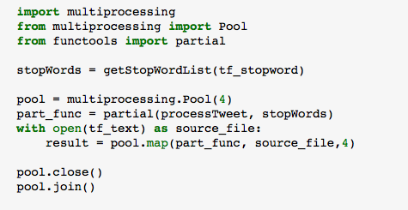
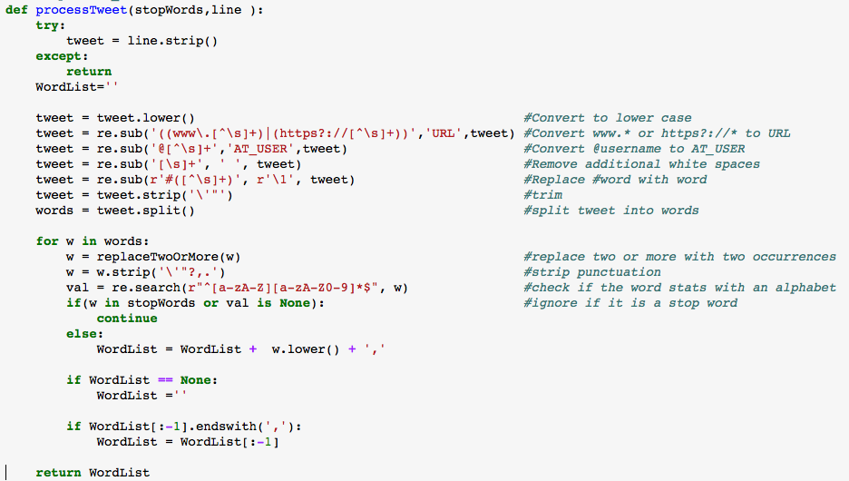
How to get tweets? Python - Multiprocessing
Multiprocessing to read and process tweets by worker
multiprocessing.Pool(processes)
A process pool object which controls a pool
of worker processes to which jobs can be
submitted
map(func, iterable[, chunksize])
A parallel equivalent of the map() built-in function (it supports only one iterable argument though). The Pool.map will lock the main program until all a process is finished, which is quite useful if we want to obtain resuls in a particular order for certain applications.

Slide 11
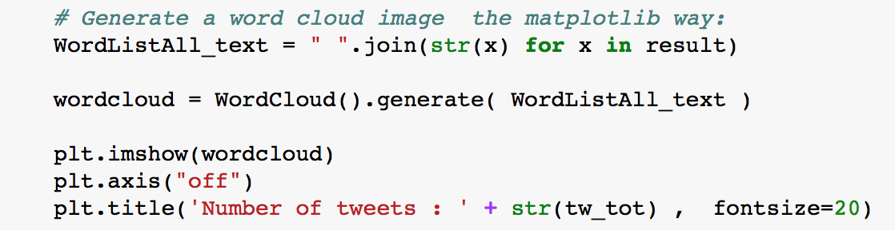
How to get tweets? Python - WordCloud library
Twitter API authentication, retrieve real-time tweets and record it.
Listen the Twitter API for new tweets
Record tweets text properties by time-period or after certain number of tweets retrieved
Run second python program by time-period or after certain number of tweets retrieved

Slide 12
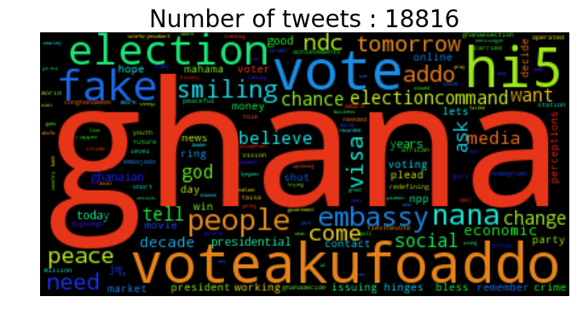
How to get tweets? Python - WordCloud library

Slide 13
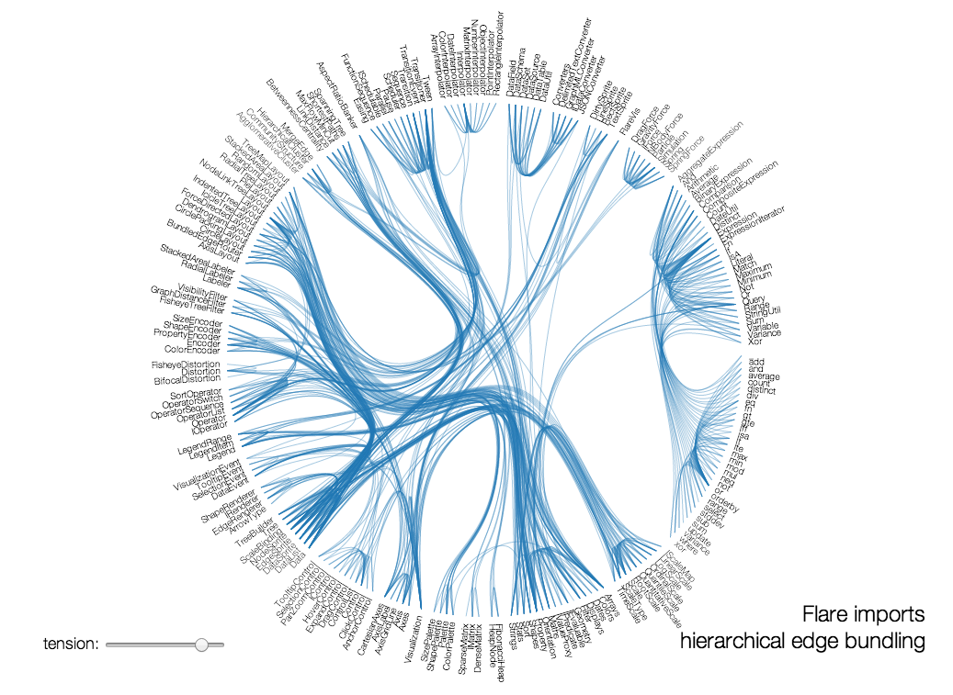
D3.js - D3 for Data-Driven Documents
Producing dynamic,interactive data visualization
Solves the fundamental problem of data visualization
Supports differential data update
Creates SVG (Scalable Vector Graphics ) elements
helps to facilitate zoom-in, zoom-out functions

Slide 14
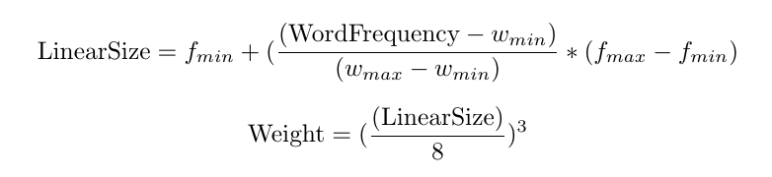
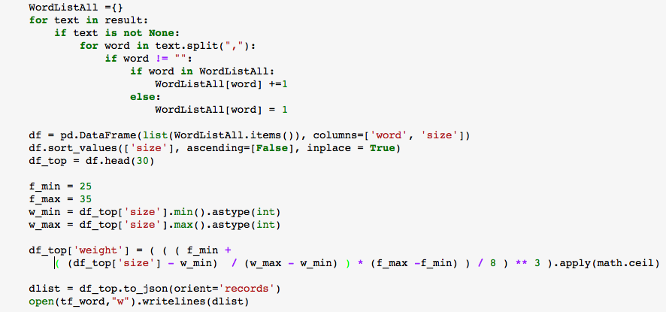
How to get tweets? Python – Word frequencies for D3.js WordCloud
Find word frequencies and calculate the weight based on frequencies
For weight calculation :http://www.bennybottema.com/2016/03/02/showcase-your-skillset-with-an-interactive-colorful-d3-js-tag-cloud/

Slide 15
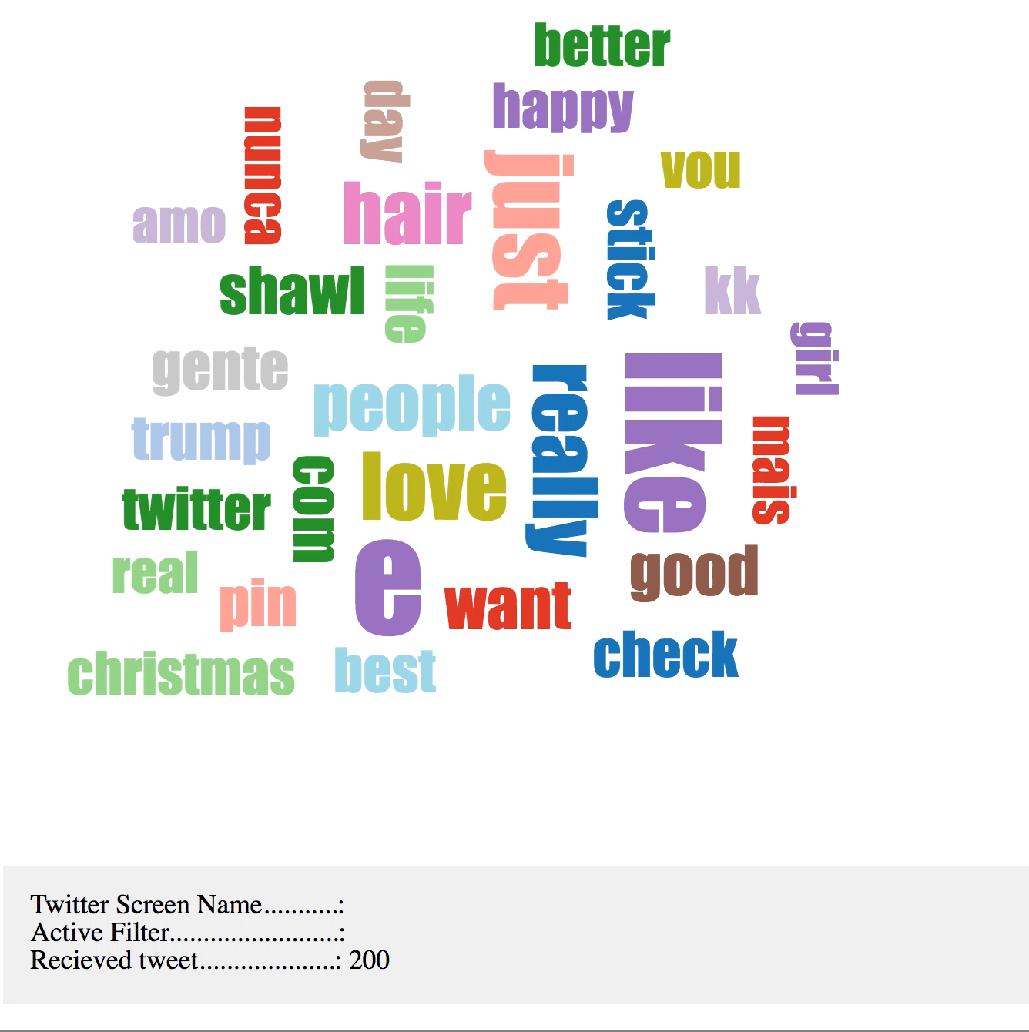
JavaScript D3.js
Interactive Visualization for text files (most popular top 30 words)
Interactive updates for new top words
Transition animation brings focus on the important changes

Slide 16
Conclusion - 1
Get data from twitter and generate most used word visualization
Yes, I was able to get new tweets and most recent 3200 tweets for selected user
Find Historical twitter data for 2016 Presidential Election day
Twitter has one week restriction for old tweets, but if you have tweet ID’s you can get it . 2016 Election day there was more than 40 million tweets. I found tweet ID’s for 20 Million tweets, but It was to slow to retrieve it one by one.
Create Word Cloud to analyze twitter social media for selected filter
Yes
It is great to find out what social media talks about a subject by just using a simple filter

Slide 17
Conclusion - 2
Python Multithreading needs to improve, so complex, I could’t use it
Python Multiprocessing increased the performance significantly
C OpenMP and C MPI are more powerful
Tweepy is a great open-source library to access to the Twitter API, heavily relies on it and has great Streaming API support

Slide 18
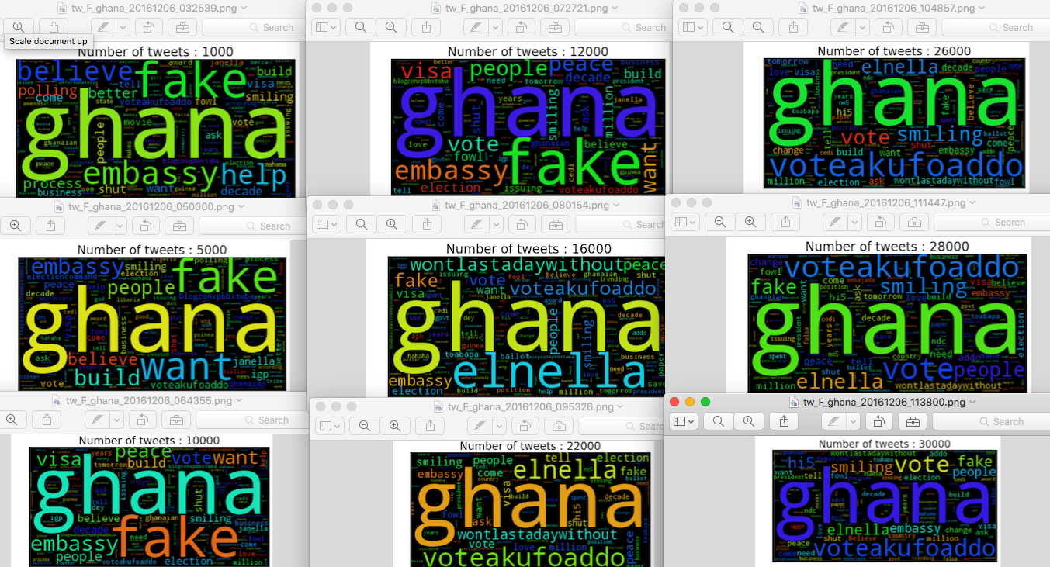
Filter: ‘Ghana’ Tweets for Dec 6 2016 (8:25am-4:38pm)

Slide 19
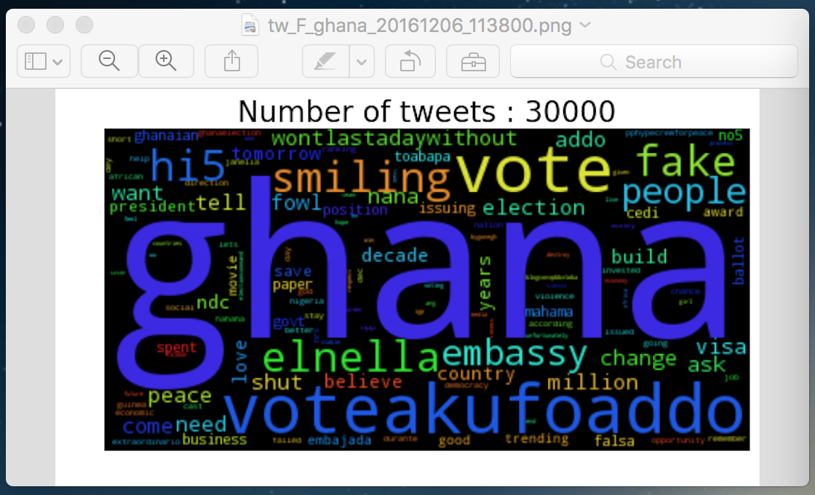
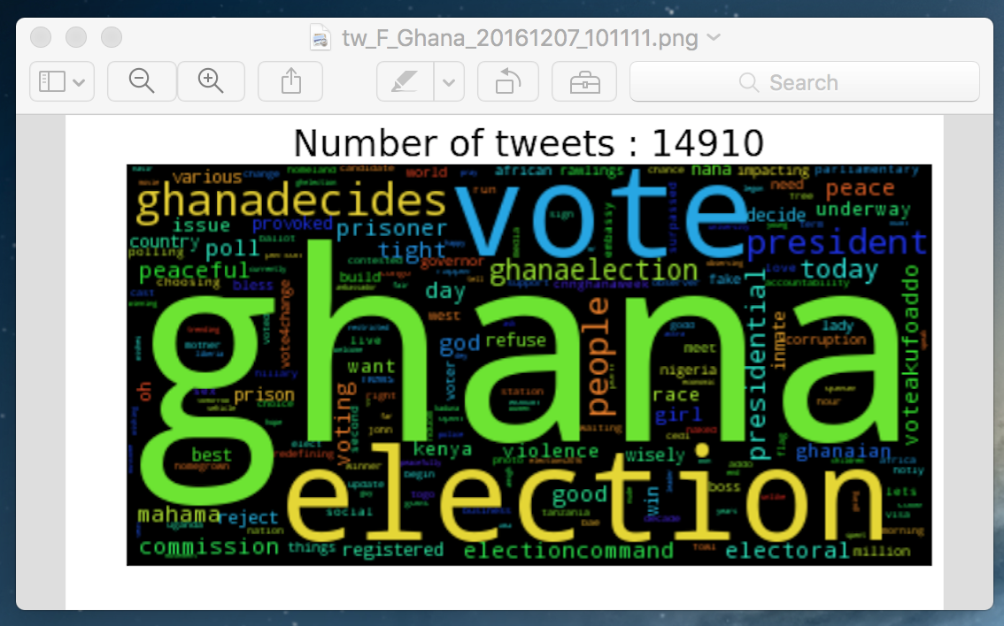
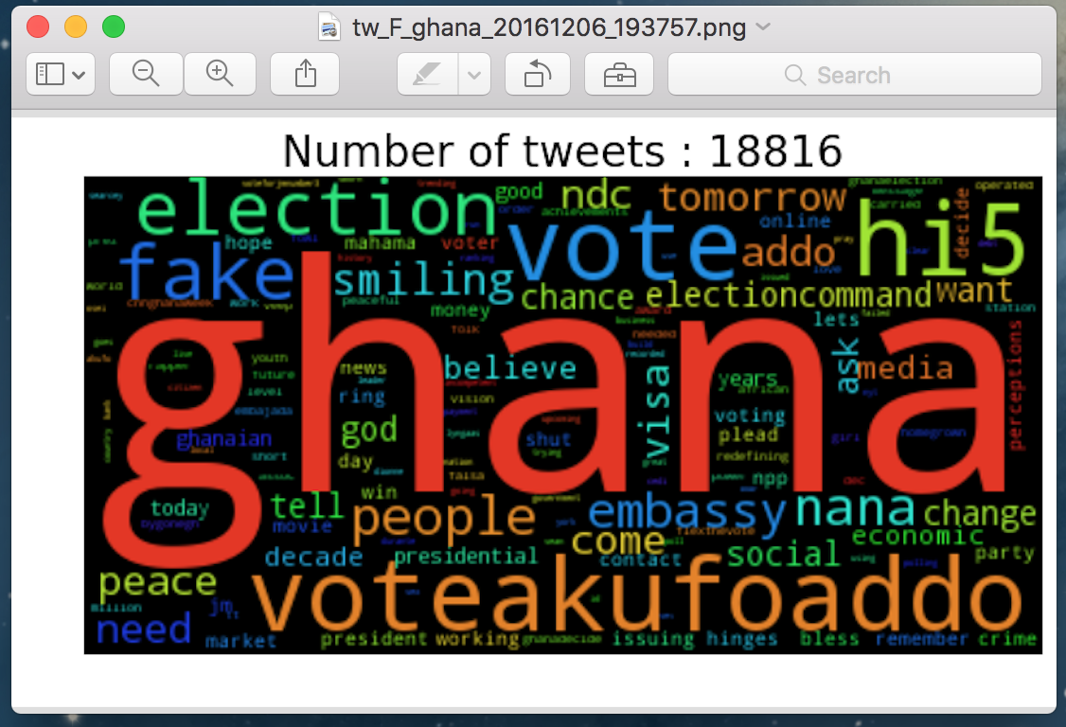
Ghana Election
Dec 7,2016 (today)
Dec 6,2016
Presidential Candidate
*John Draman Mahama
Ivor Greenstreet
Nana Akufo-Addo (addo , voteakufoaddo)
Pae Kwesi Nduon
Edward Mahama
Nana Konadu A. R
Jacob Osei Yeboah
Notes:
https://en.wikipedia.org/wiki/Ghanaian_general_election,_2016

Slide 20
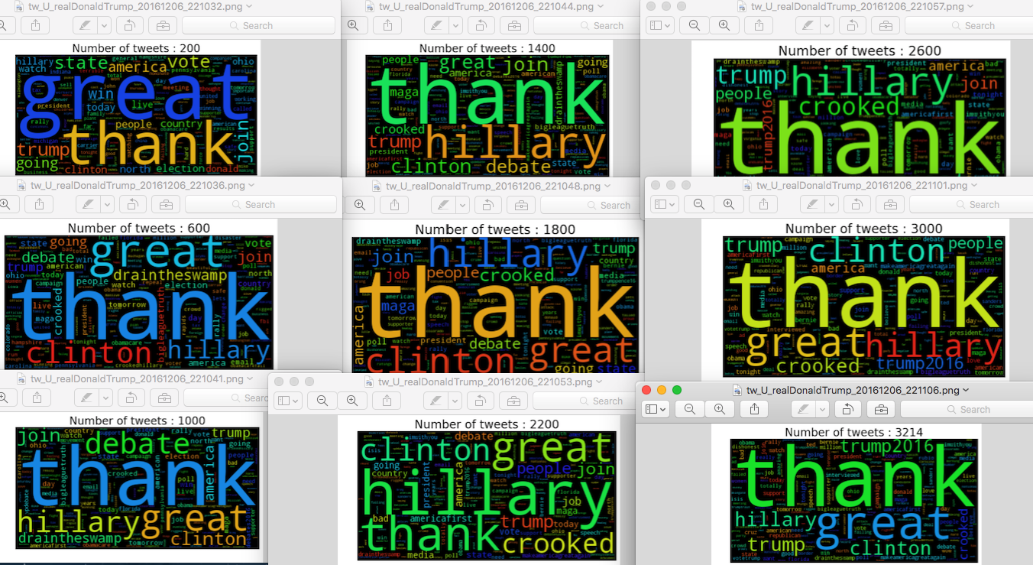
Python-WordCloud @realDonaldTrump Tweets:34.1K

Slide 21
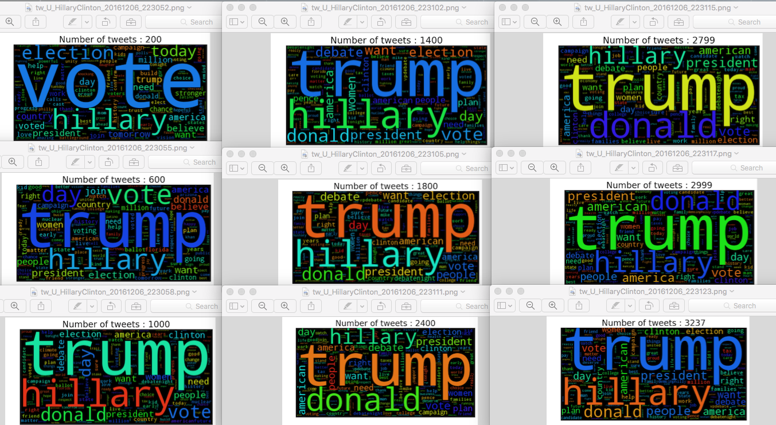
Python-WordCloud @HillaryClinton Tweets:9.8K

Slide 22
The End
Thank You
Feel free to ask Questions

